Slide 1
4.48 psychosis
Sarah kane

Slide 2
About Sarah Kane
‘In-Yer-Face’ Theatre was a term used to describe drama that was emerging in the 1990’s. Seen to be the type of theatre that grabs the audience by the scruff of the neck and shakes it until it gets the message.
Sarah Kane was born in 1971 and unfortunately died at 28 years old in 1999. She died by committing suicide and this was by her taking her shoelaces and tying them to a hospital door and hanging herself. She tried before to kill herself by taking 150 antidepressants.
She wrote 6 plays and some of these were Crave, Cleanse, 4.48 Psychosis,
She went to University of Birmingham to do a further study within playwriting.
She despised religion and this was noticeable throughout 4.48 Psychosis. She thought that she was a born again christian in her late teens but later decided she hated religion.
There are a lot of metaphors, pronouns and references to the bible within all of her plays.
She was seen to be the face of ‘In-Yer-Face’ Theatre and it is a attack of modern society. It was seen to be a metaphysical issue.
In her play called cleanse she wrote about relating University dorms to concentration camps.
She was always attacked by critics publicly and this was over front pages on newspapers.
She struggled with her sexuality and we didn’t know whether that was due to her religion or not.

Slide 3
About 4.48
It was the last play that she wrote before she committed suicide.
4.48 Psychosis was seen as a suicide note by the public but her family refused to believe that this was true.
4.48 is a time that was known for people that wanted to committ suicide. This is a bibliographical time.
It has 24 scenes and some of these are longer and use more paragraphs within them, but some of them are shorter and just simple sentences. (Two scenes are just numbers on the page).
It doesn’t talk about gender, stage directions, how many people there are and their ages, a setting or time.
It doesn’t use traditional theatre form and therefore punctuation such as full stops can suggest a heartbeat.
People have thought about different interpretations for this play such as it all being a psychotic episode.
There are a multitude of voices within the play and there is no idea of how Sarah kane wanted it staged.
It is written in a non linear way
Doesn’t use traditional theatre form

Slide 4
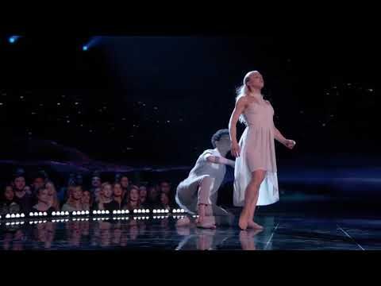
My idea:
My idea is formed from scene 10 in the script. This scene seems to come across that it is the conversation going on between a patient and someone trying to help. There is also a hint of shame come across in their conversation and blame on the patient on why they would do that to them self in the first place.
There will be 2 dancers perform this dance and i would like to choreograph and perform in the dance too. It will be about a helper figure and the patient and will be a complete contact dance and purposely will be made to make people uncomfortable when they watch it.
The person playing the role of the patient i would like to represent the feeling of being embarrassed and misunderstood for their actions also being trapped and not wanting help of anyone or there pity because they don’t understand what they are going through. I would like the audience to feel
The other person who will be playing the part of the helper i want then to show the concern of someone who is trying to help that person but doesn’t know how or why they are doing this to themself and can’t help them so cant leave them alone because of their situation.
I would also like to use contemporary as my main style in the dance but a not against adding other styes in if they fit and link together with the contact work.
I found this clip from world of dance competition and i liked the connection between the two dancers and how they used their factual expressions and contact work to show the support they have for each other and helping one another through their struggles and made it look like a helper and patient. In this one that the patient is trying to reach the light and they are being helped to finally find that peace there looking for.
I also like the way they use up all of the space on stage in the dance and is not just performed to the front of the room. Their sharp and prosise movement fit the theme because it could represent someone in there psychotic episode and they have a really good use of the contemporary style and haven't made it look like a lyrical dance.

Slide 5
Other inspirations for my dance
This 2 tik toks that i found show off some contact stunts that i could use as inspiration in the choreography i will create.
I have also linked my idea to American Horror story season 1 and based around the characters Tate and Violet which represents the helper (Tate) and the patient (Violet). In the series Violet struggles with her mental illness and is seen self harming like the play and much like sarah kane herself. Later on in the series she overdoses on pills and unfortunately ends up dying while Tate tries to save her. Tate also had asked Violet about her cuts all over her arm and why she did them exactly like the script and the conversation going on in it. He is also seen helping her through her problems and mental health but is unsuccessful lie the helper in 4.48.
One of the conversations between tate and violet about her self harming like the script. https://www.youtube.com/watch?v=sj9QVtyrHWk time in video 1.16 – 1.28
I have got 2 song ideas for my piece
Song- 1 The theme song for american horror story is creepy music to add to uncomfortableness of the dance.
https://www.youtube.com/watch?v=1qXiKIM0TKA
Song- 2 Is a heartbeat monitor and to add the thought that the patient might have tried to harm/injure themself and ended up in hospital and is a doctor trying to help them.
https://www.youtube.com/watch?v=tpi5RoNmvTU
We did a class workshop on contact work and some of the class came up with a phrase to show off the different things we learnt, we also had a workshop with the RSC and motion house that we also learnt 2 man stunts that will fit in the dance and can make them all link together and give me inspiration for my own choreography.

